Slide 1
UFT - Basics

Slide 2
Version Control and Revision History
 | Name | Date
Prepared by | Sneha Kumar | 07-Mar-2019
Reviewed by | Nisha Mendonsa | 07-Mar-2019
Approved by | Gauresh Gaitonde | 08-Mar-2019
Version No. | Date | Affected Sections | Highlights
1.0.0 | 08-Mar-2019 | All | Original Version

Slide 3
Agenda – Session 1 & 2
Manual Vs Automation
Functional Testing Process
Introduction of QTP
New Features in 11.5
Recording modes
Object Repository
Synchronization
Parameterization
Checkpoints

Slide 4
Manual Vs Automation
Manual Testing | Automation Testing
Executing STLC with human efforts | Executing STLC with Tools or interface
Time consuming and tedious | Fast
Less reliable | More reliable
Non-programmable | Programmable
Suitable for one time testing | Repeatable testing

Slide 5
Functional Testing Process
Requirements
Test Plan
Test Script Generation
Test Script Execution
Defect Tracking

Slide 6
Introduction to QTP
Parameters | Contents
Purpose | Functional & Regression testing
Latest Version | 12.54
Technology | Object Oriented Technology
Scripting | VB scripting / Java scripting
O/s Support | Windows
AUT | Any GUI based ( web / windows)
Specialty | Keyword driven testing tool
Developed Environment | .NET
Vendor | HP

Slide 7
New Features in QTP 11.5
One Unified Tool for GUI + API testing
Parameters | contents
Browser support | Internet Explorer, Chrome, Firefox
Application support | Any GUI based ( web / windows)
Features | Record Toolbar , Automatically Export Run Results, Image-Based Object Identification
compatibility with other tools | QC

Slide 8

Assignment
Comparative study on versions of QTP
Version 10
Version 11
Version 11.5
For below specified Parameters
Browser support
Application support
Features added from previous version
Compatibility with other tools

Slide 9
Recording Modes
Capturing the user actions on the application and the script will be generated automatically

Slide 10
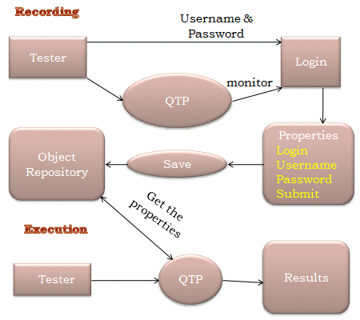
Normal Mode
Step1:Tester records the Login of Flight Reservation application.
Step2:QTP monitors the recording & saves the properties of Login in Object Repository
Step3:During Execution QTP makes use of Object Repository to identify the objects of application.
Notes:
Software Testing by Ron Patton

Slide 11
Analog Mode
Record relative to the screen
Record relative to the window
listens
Mouse Actions
QTP
Low Level Mode
Unrecognized objects
Example: symbols like

Slide 12

Assignment
Create a script for web based flight reservation
Login credentials are below:
User name :jojo
Password : bean
Create a script for my atos syntel
Respective user id are to be used for Login.
Create script using Analog recording for sign out in my atos syntel.
Create script using Low level recording for Atos Syntel university in my atos syntel.

Slide 13
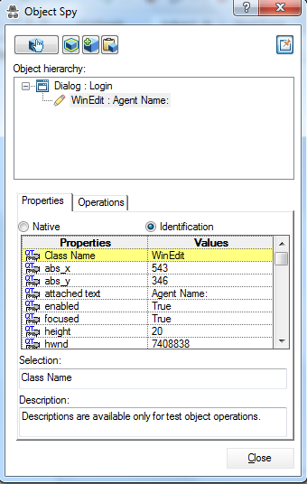
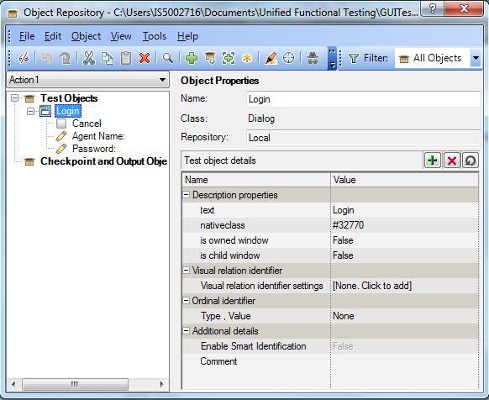
Object Repository & Spy
Repository stores the objects properties
Spy inspects the object properties

Slide 14

Assignment
create per action repository for my atos syntel
( login , attendance , syntel university)
all per actions repository are to be merged to
Create a shared repository.

Slide 15
Synchronization
Waitproperty (GUI Application)
Window("Flight Reservation").WinButton("Insert Order").WaitProperty "enabled", 0, 20000
Sync (Web based Application)
Browser("Welcome: Mercury Tours").Page("Sign-on: Mercury Tours").Sync
Wait Statement (GUI and Web)
Wait(20)
3 Types
Waitproperty
Sync
Wait

Slide 16
Synchronization Point
It solves the anticipated time out problem
Procedures for inserting synchronization point,
Start recording, Place the Cursor in the script to insert synchronization point
Design-> Synchronization Point
Capture the Insert Order button
Specify the Property Name as Enabled, Property Value as 0 and Timeout as 20000 milliseconds
Stop Recording
Execute and Analyze the results

Slide 17
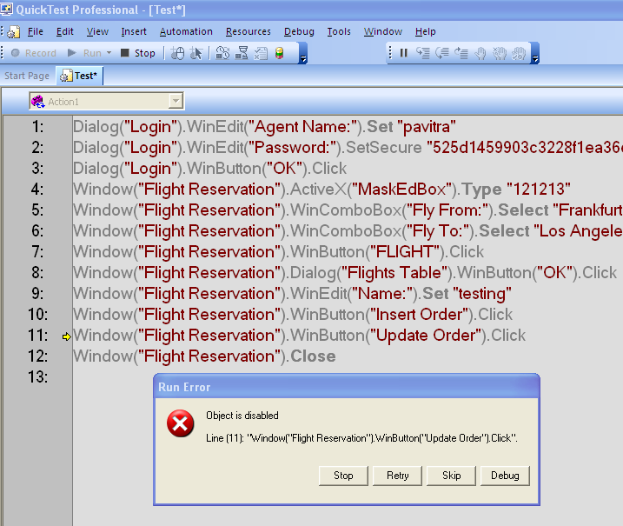
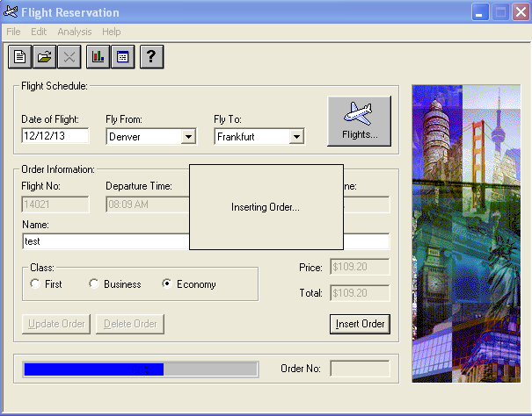
Synchronization Point

Slide 18
Parameterization
Process of giving multiple Input/Test data to the test script
2 ways to parameterize
Data Driver Wizard
Keyword View
Data Driver Wizard
- Record a script by providing Agent Name and Password.
- Go to Tools -> Data Driver
- The following Data Driver dialog box opens

Slide 19
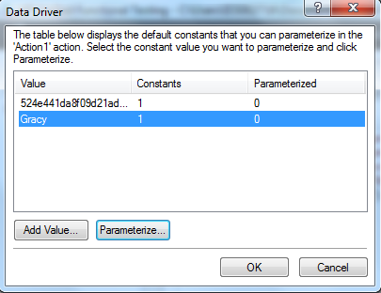
- Click Parameterize in the above wizard

Slide 20
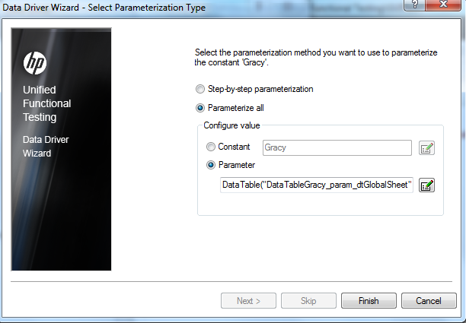
- Click Finish

Slide 21
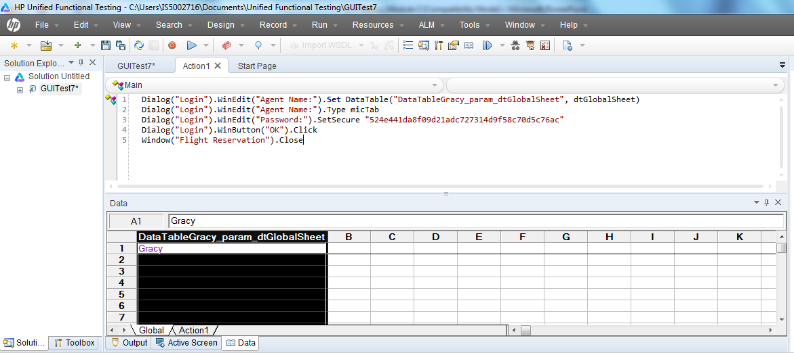
- Provide the values to be passed for Agent Name
- Run and analyze the results

Slide 22

Assignment
Parameterize my atos syntel application
for multiple inputs.
Open the excel in datatable and parameterize
for Flight reservation application.

Slide 23
Checkpoints
A checkpoint is a verification point that compares a current value for a specified property with the expected value for that property.
This enables you to identify whether your Web site or application is functioning correctly.
Checkpoints can be applied for web based & window based application.

Slide 24
Types of Checkpoints
Types | Features
Standard checkpoint | It checks the property value of an object in your application or Web page.
Text Checkpoint | It checks that a text string is displayed in the appropriate place in your application or on a Web page
Text Area Checkpoint | It checks that a text string is displayed within a defined area in a Windows application.
Bitmap checkpoint | It compares the bitmaps: We can complete bitmaps as well as part of the bitmaps
Database checkpoint | It is used to check the database contents
Xml Checkpoint | It is used to check the xml file contents
Accessibility Checkpoint | It checks whether the webpage in our web application is developed according to W3C (World Wide Web consortium) Rules and Regulations or not.

Slide 25
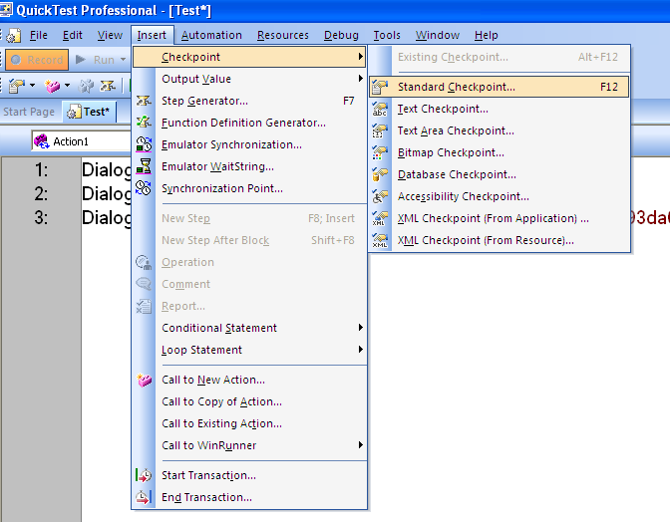
Procedure for Standard Checkpoint:
Scenario : Validate the Enable status of the Help Button in Flight Reservation window
1. Start recording
2. Open flight application
3. Go to insert->checkpoint->standard checkpoint
4. Drag and drop the hand icon on the "Help" Button
5. Enable a checkbox "Enabled"
6. Provide the expected value in the constant edit box
Eg: False
7. Click ok
8. Close the application
9. Stop recording
10. Run the script

Slide 26
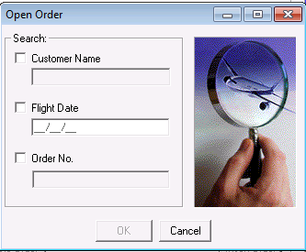
Assignment for Checkpoint
Validate the Open Order window for the Flight Reservation
Customer name enabled with Flight Date
When Order No Enabled the other 2 options disabled
Flight Date enabled with Customer Name
OK Button Enabled when any of the above options enabled

